Slide 1
Data Mining & Business Intelligence
Module 5:Frequent Pattern Mining

Slide 2
Index -
Lecture 28-Association rule mining and market basket analysis | 4
Lecture 29 - Association Rules,Frequent Pattern Mining | 9
Lecture 30- The Apriori Algorithm for finding, Frequent Itemsets Using Candidate Generation | 14
Lecture 31- Improving the Efficiency of Apriori, A pattern growth approach, for mining Frequent Itemsets | 22

Slide 3
Lecture 28
Association Rule Mining and Market Basket Analysis

Slide 4
What Is Association Mining?
Association rule mining:
  Finding frequent patterns, associations, correlations, or causal structures among sets of items or objects in transaction databases, relational databases, and other information repositories.
Applications:
  Basket data analysis, cross-marketing, catalog design, loss-leader analysis, clustering, classification, etc.
Examples.
  Rule form: “Body ® Head [support, confidence]”.
  buys(x, “diapers”) ® buys(x, “beers”) [0.5%, 60%]
  major(x, “CS”) ^ takes(x, “DB”) ® grade(x, “A”) [1%, 75%]
Lecture 28-Association rule mining and market basket analysis

Slide 5
Introduction to Market Basket Analysis
Def: Market Basket Analysis (Association Analysis) is a mathematical modeling technique based upon the theory that if you buy a certain group of items, you are likely to buy another group of items.
It is used to analyze the customer purchasing behavior and helps in increasing the sales and maintain inventory by focusing on the point of sale transaction data.
Given a dataset, the Apriori Algorithm trains and identifies product baskets and product association rules
Lecture 28-Association rule mining and market basket analysis

Slide 6
Definitions and Terminology
Transaction is a set of items (Itemset).
Confidence : It is the measure of uncertainty or trust worthiness associated with each discovered pattern.
Support : It is the measure of how often the collection of items in an association occur together as percentage of all transactions
Frequent itemset : If an itemset satisfies minimum support,then it is a frequent itemset.
Strong Association rules: Rules that satisfy both a minimum support threshold and a minimum confidence threshold
In Association rule mining, we first find all frequent itemsets and then generate strong association rules from the frequent itemsets
Lecture 28-Association rule mining and market basket analysis

Slide 7
Definitions and Terminology- Continued
Apriori algorithm is the most established algorithm for finding frequent item sets mining.
The basic principle of Apriori is “Any subset of a frequent itemset must be frequent”.
We use these frequent itemsets to generate association rules.
Lecture 28-Association rule mining and market basket analysis

Slide 8
Lecture 29
Association Rules, Frequent Pattern Mining

Slide 9
Association Rule: Basic Concepts
Given: (1) database of transactions, (2) each transaction is a list of items (purchased by a customer in a visit)
Find: all rules that correlate the presence of one set of items with that of another set of items
  E.g., 98% of people who purchase tires and auto accessories also get automotive services done
Applications
  * ⇒ Maintenance Agreement (What the store should do to boost Maintenance Agreement sales)
  Home Electronics ⇒ * (What other products should the store stocks up?)
  Attached mailing in direct marketing
  Detecting “ping-pong”ing of patients, faulty “collisions”
Lecture 29 - Association Rules,Frequent Pattern Mining

Slide 10
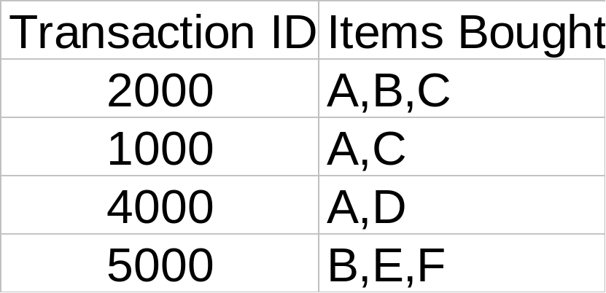
Rule Measures: Support and Confidence
Customer
buys both
Find all the rules X & Y ⇒ Z with minimum confidence and support
  support, s, probability that a transaction contains {X ∩ Y ∩ Z}
  confidence, c, conditional probability that a transaction having {X ∩ Y} also contains Z
Customer
buys diaper
Customer
buys beer
Let minimum support 50%, and minimum confidence 50%, we have
  A ⇒ C (50%, 66.6%)
  C ⇒ A (50%, 100%)
Lecture 29 - Association Rules, Frequent Pattern Mining

Slide 11
Association Rule Mining: A Road Map
Boolean vs. quantitative associations (Based on the types of values handled)
  buys(x, “SQLServer”) ^ buys(x, “DMBook”) → buys(x, “DBMiner”) [0.2%, 60%]
  age(x, “30..39”) ^ income(x, “42..48K”) → buys(x, “PC”) [1%, 75%]
Single dimension vs. multiple dimensional associations (see ex. Above)
Single level vs. multiple-level analysis
  What brands of beers are associated with what brands of diapers?
Various extensions
  Correlation, causality analysis
    Association does not necessarily imply correlation or causality
  Maxpatterns and closed itemsets
  Constraints enforced
    E.g., small sales (sum < 100) trigger big buys (sum > 1,000)?
Lecture 29 - Association Rules,Frequent Pattern Mining

Slide 12
Mining Association Rules in Large Databases
Association rule mining
Mining single-dimensional Boolean association rules from transactional databases
Mining multilevel association rules from transactional databases
Mining multidimensional association rules from transactional databases and data warehouse
From association mining to correlation analysis
Constraint-based association mining
Summary
Lecture 29 - Association Rules,Frequent Pattern Mining

Slide 13
Lecture 30
The Apriori Algorithm for finding, Frequent Itemsets Using Candidate Generation

Slide 14
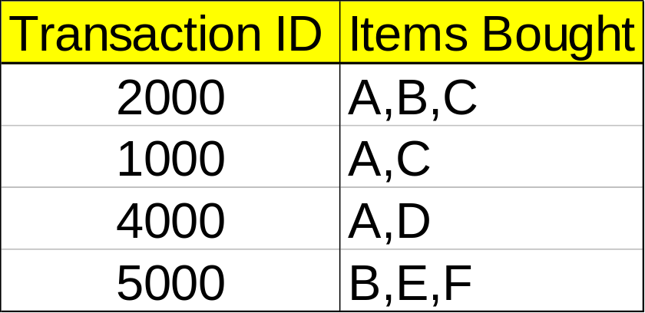
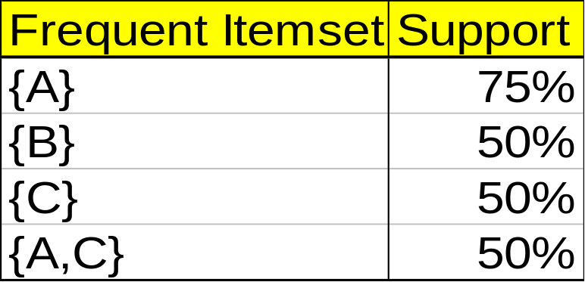
Mining Association Rules—An Example
For rule A ⇒ C:
  support = support({A ∩ C}) = 50%
  confidence = support({A ∩ C})/support({A}) = 66.6%
The Apriori principle:
  Any subset of a frequent itemset must be frequent
Min. support 50%
Min. confidence 50%
Lecture 30- The Apriori Algorithm for finding, Frequent Itemsets Using Candidate Generation

Slide 15
Mining Frequent Itemsets: the Key Step
Find the frequent itemsets: the sets of items that have minimum support
  A subset of a frequent itemset must also be a frequent itemset
    i.e., if {AB} is a frequent itemset, both {A} and {B} should be a frequent itemset
  Iteratively find frequent itemsets with cardinality from 1 to k (k-itemset)
Use the frequent itemsets to generate association rules.
Lecture 30- The Apriori Algorithm for finding, Frequent Itemsets Using Candidate Generation

Slide 16
The Apriori Algorithm
Join Step: C_{k} is generated by joining L_{k-1}with itself
Prune Step: Any (k-1)-itemset that is not frequent cannot be a subset of a frequent k-itemset
Pseudo-code:
    C_{k}: Candidate itemset of size k
    L_{k} : frequent itemset of size k
    L₁ = {frequent items};
    for (k = 1; L_{k} !=∅; k++) do begin
    C_{k+1} = candidates generated from L_{k};
    for each transaction t in database do
      increment the count of all candidates in C_{k+1} that are contained in t
    L_{k+1} = candidates in C_{k+1} with min_support
    end
    return ∪_{k} L_{k};
Lecture 30- The Apriori Algorithm for finding, Frequent Itemsets Using Candidate Generation

Slide 17








The Apriori Algorithm — Example
Database D
L₁
C₁
Scan D
C₂
C₂
L₂
Scan D
C₃
Scan D
L₃

Slide 18
How to Generate Candidates?
Suppose the items in L_{k-1} are listed in an order
Step 1: self-joining L_{k-1}
  insert into C_{k}
  select p.item₁, p.item₂, …, p.item_{k-1}, q.item_{k-1}
  from L_{k-1} p, L_{k-1} q
  where p.item₁=q.item₁, …, p.item_{k-2}=q.item_{k-2}, p.item_{k-1} < q.item_{k-1}
Step 2: pruning
  forall itemsets c in C_{k} do
    forall (k-1)-subsets s of c do
      if (s is not in L_{k-1}) then delete c from C_{k}
Lecture 30- The Apriori Algorithm for finding, Frequent Itemsets Using Candidate Generation

Slide 19
How to Count Supports of Candidates?
Why counting supports of candidates a problem?
  The total number of candidates can be very huge
  One transaction may contain many candidates
Method:
  Candidate itemsets are stored in a hash-tree
  Leaf node of hash-tree contains a list of itemsets and counts
  Interior node contains a hash table
  Subset function: finds all the candidates contained in a transaction
Lecture 30- The Apriori Algorithm for finding, Frequent Itemsets Using Candidate Generation

Slide 20
Example of Generating Candidates
L₃={abc, abd, acd, ace, bcd}
Self-joining: L₃*L₃
  abcd from abc and abd
  acde from acd and ace
Pruning:
  acde is removed because ade is not in L₃
C₄={abcd}
Lecture 30- The Apriori Algorithm for finding, Frequent Itemsets Using Candidate Generation

Slide 21
Lecture 31
Improving the Efficiency of Apriori, A pattern growth approach, for mining Frequent Itemsets

Slide 22
Methods to Improve Apriori’s Efficiency
Hash-based itemset counting: A k-itemset whose corresponding hashing bucket count is below the threshold cannot be frequent
Transaction reduction: A transaction that does not contain any frequent k-itemset is useless in subsequent scans
Partitioning: Any itemset that is potentially frequent in DB must be frequent in at least one of the partitions of DB
Sampling: mining on a subset of given data, lower support threshold + a method to determine the completeness
Dynamic itemset counting: add new candidate itemsets only when all of their subsets are estimated to be frequent
Lecture 31- Improving the Efficiency of Apriori, A pattern growth approach, for mining Frequent Itemsets

Slide 23
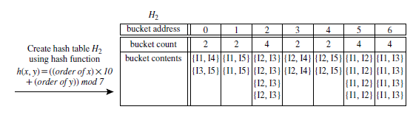
Hash Based Technique
Hash-based technique (hashing itemsets into corresponding buckets): A hash-based
technique can be used to reduce the size of the candidate k-itemsets, Ck, for k > 1.
For example, when scanning each transaction in the database to generate the frequent
1-itemsets, L1, we can generate all the 2-itemsets for each transaction, hash (i.e., map)
Lecture 31- Improving the Efficiency of Apriori, A pattern growth approach, for mining Frequent Itemsets

Slide 24
Contd…
them into the different buckets of a hash table structure, and increase the corresponding
bucket counts (Figure 6.5). A 2-itemset with a corresponding bucket count in the
hash table that is below the support threshold cannot be frequent and thus should
be removed from the candidate set. Such a hash-based technique may substantially
reduce the number of candidate k-itemsets examined (especially when k D 2).
Lecture 31- Improving the Efficiency of Apriori, A pattern growth approach, for mining Frequent Itemsets

Slide 25
Generating Rules from Frequent Itemsets
For each set S belonging to the frequent itemset: generate rules that contain all the items in S and test if they satisfy the confidence constraint:
Approach: Generate all possible rules (approach described in Han’s book); e.g. for {D,E,F} the following candidate rules are created: E→DF, D→EF, F→ED, DF→E, EF→D, ED→F
Lecture 31- Improving the Efficiency of Apriori, A pattern growth approach, for mining Frequent Itemsets

Slide 26

Visualization of Association Rule Using Plane Graph

Slide 27

Visualization of Association Rule Using Rule Graph

Slide 28
Introduction
Apriori: uses a generate-and-test approach – generates candidate itemsets and tests if they are frequent
  Generation of candidate itemsets is expensive(in both space and time)
  Support counting is expensive
    Subset checking (computationally expensive)
    Multiple Database scans (I/O)
FP-Growth: allows frequent itemset discovery without candidate itemset generation. Two step approach:
  Step 1: Build a compact data structure called the FP-tree
    Built using 2 passes over the data-set.
  Step 2: Extracts frequent itemsets directly from the FP-tree
Lecture 31- Improving the Efficiency of Apriori, A pattern growth approach, for mining Frequent Itemsets

Slide 29
Step 1: FP-Tree Construction
FP-Tree is constructed using 2 passes over the data-set:
Pass 1:
  Scan data and find support for each item.
  Discard infrequent items.
  Sort frequent items in decreasing order based on their support.
Use this order when building the FP-Tree, so common prefixes can be shared.
Lecture 31- Improving the Efficiency of Apriori, A pattern growth approach, for mining Frequent Itemsets

Slide 30
Step 1: FP-Tree Construction
Pass 2:
Nodes correspond to items and have a counter
FP-Growth reads 1 transaction at a time and maps it to a path
Fixed order is used, so paths can overlap when transactions share items (when they have the same prefix ).
  In this case, counters are incremented
Pointers are maintained between nodes containing the same item, creating singly linked lists (dotted lines)
  The more paths that overlap, the higher the compression. FP-tree may fit in memory.
Frequent itemsets extracted from the FP-Tree.
Lecture 31- Improving the Efficiency of Apriori, A pattern growth approach, for mining Frequent Itemsets

Slide 31
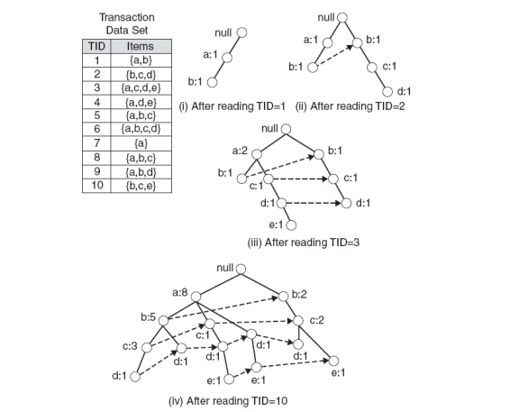
Step 1: FP-Tree Construction (Example)
Lecture 31- Improving the Efficiency of Apriori, A pattern growth approach, for mining Frequent Itemsets

Slide 32
FP-Tree size
The FP-Tree usually has a smaller size than the uncompressed data - typically many transactions share items (and hence prefixes).
  Best case scenario: all transactions contain the same set of items.
    1 path in the FP-tree
  Worst case scenario: every transaction has a unique set of items (no items in common)
    Size of the FP-tree is at least as large as the original data.
    Storage requirements for the FP-tree are higher - need to store the pointers between the nodes and the counters.
The size of the FP-tree depends on how the items are ordered
Ordering by decreasing support is typically used but it does not always lead to the smallest tree (it's a heuristic).
Lecture 31- Improving the Efficiency of Apriori, A pattern growth approach, for mining Frequent Itemsets

Slide 33
Step 2: Frequent Itemset Generation
FP-Growth extracts frequent itemsets from the FP-tree.
Bottom-up algorithm - from the leaves towards the root
Divide and conquer: first look for frequent itemsets ending in e, then de, etc. . . then d, then cd, etc. . .
First, extract prefix path sub-trees ending in an item(set). (hint: use the linked lists)
Lecture 31- Improving the Efficiency of Apriori, A pattern growth approach, for mining Frequent Itemsets

Slide 34
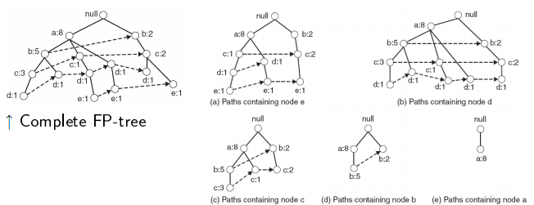
Prefix path sub-trees (Example)
Lecture 31- Improving the Efficiency of Apriori, A pattern growth approach, for mining Frequent Itemsets

Slide 35
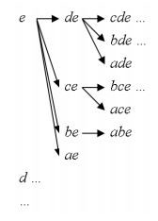
Step 2: Frequent Itemset Generation
Each prefix path sub-tree is processed recursively to extract the frequent itemsets. Solutions are then merged.
  E.g. the prefix path sub-tree for e will be used to extract frequent itemsets ending in e, then in de, ce, be and ae, then in cde, bde, cde, etc.
  Divide and conquer approach
Lecture 31- Improving the Efficiency of Apriori, A pattern growth approach, for mining Frequent Itemsets

Slide 36
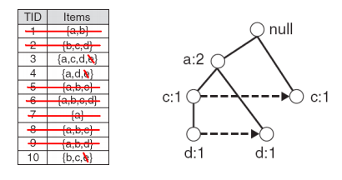
Conditional FP-Tree
The FP-Tree that would be built if we only consider transactions containing a particular itemset (and then removing that itemset from all transactions).
I Example: FP-Tree conditional on e.
Lecture 31- Improving the Efficiency of Apriori, A pattern growth approach, for mining Frequent Itemsets

Slide 37
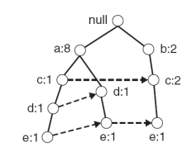
Example
Let minSup = 2 and extract all frequent itemsets containing e.
1. Obtain the prefix path sub-tree for e:
Lecture 31- Improving the Efficiency of Apriori, A pattern growth approach, for mining Frequent Itemsets

Slide 38
Example
2. Check if e is a frequent item by adding the counts along the linked list (dotted line). If so, extract it.
  Yes, count =3 so {e} is extracted as a frequent itemset.
3. As e is frequent, find frequent itemsets ending in e. i.e. de, ce, be and ae.
Lecture 31- Improving the Efficiency of Apriori, A pattern growth approach, for mining Frequent Itemsets

Slide 39
Example
4. Use the the conditional FP-tree for e to find frequent itemsets ending in de, ce and ae
  Note that be is not considered as b is not in the conditional FP-tree for e.
I For each of them (e.g. de), find the prefix paths from the conditional tree for e, extract frequent itemsets, generate conditional FP-tree, etc... (recursive)
Lecture 31- Improving the Efficiency of Apriori, A pattern growth approach, for mining Frequent Itemsets

Slide 40
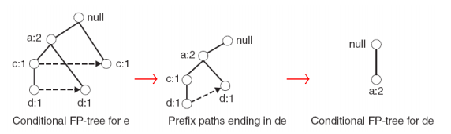
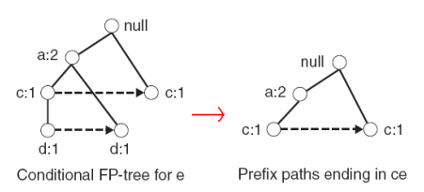
Example
Example: e -> de -> ade ({d,e}, {a,d,e} are found to be frequent)
Example: e -> ce ({c,e} is found to be frequent)

Slide 41
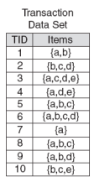
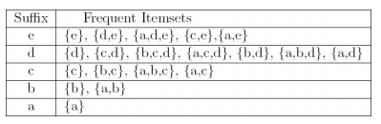
Result
Frequent itemsets found (ordered by sufix and order in which they are found):

Slide 42
Discusion
Advantages of FP-Growth
  only 2 passes over data-set
  “compresses” data-set
  no candidate generation
  much faster than Apriori
Disadvantages of FP-Growth
  FP-Tree may not fit in memory!!
  FP-Tree is expensive to build
Lecture 31- Improving the Efficiency of Apriori, A pattern growth approach, for mining Frequent Itemsets

Slide 43
Pattern-Growth Approach: Mining Frequent Patterns Without Candidate Generation
The FP-Growth Approach
  Depth-first search (Apriori: Breadth-first search)
  Avoid explicit candidate generation
FP-Growth approach:
For each frequent item, construct its conditional pattern-base, and then its conditional FP-tree
Repeat the process on each newly created conditional FP-tree
Until the resulting FP-tree is empty, or it contains only one path—single path will generate all the combinations of its sub-paths, each of which is a frequent pattern
Fp-tree construatioin:
Scan DB once, find frequent 1-itemset (single item pattern)
Sort frequent items in frequency descending order, f-list
Scan DB again, construct FP-tree
Lecture 31- Improving the Efficiency of Apriori, A pattern growth approach, for mining Frequent Itemsets

Slide 44
FP-tree Size
The size of an FP­tree is typically smaller than the size of the uncompressed data because many transactions often share a few items in common
  Best­case scenario: All transactions have the same set of items, and the FP­tree contains only a single branch of nodes.
  Worst­case scenario: Every transaction has a unique set of items. As none of the transactions have any items in common, the size of the FP­tree is effectively the same as the size of the original data.
The size of an FP­tree also depends on how the items are ordered
Lecture 31- Improving the Efficiency of Apriori, A pattern growth approach, for mining Frequent Itemsets

Slide 45
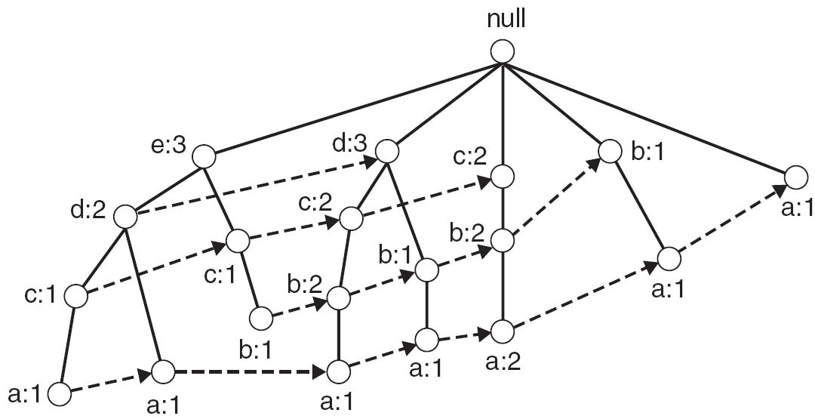
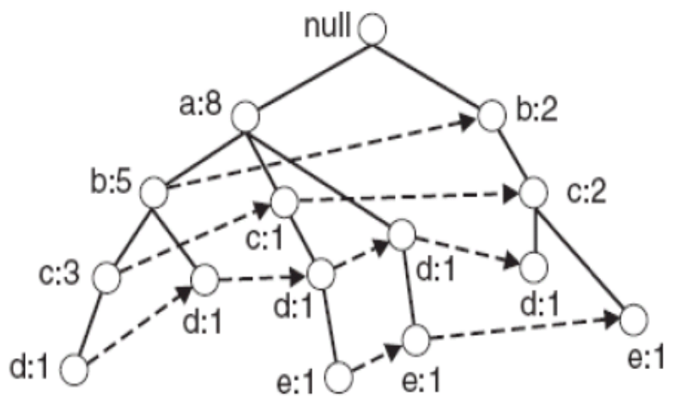
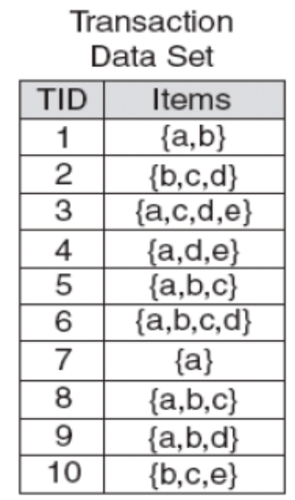
Example
FP-tree with item ascending ordering
FP-tree with item descending ordering

Slide 46
Find Patterns Having p From P-conditional Database
Starting at the frequent item header table in the FP-tree
Traverse the FP-tree by following the link of each frequent item p
Accumulate all of transformed prefix paths of item p to form p’s conditional pattern base
{}
Header Table
Item frequency head
f 4
c 4
a 3
b 3
m 3
p 3
f:4
c:1
Conditional pattern bases
item cond. pattern base
c f:3
a fc:3
b fca:1, f:1, c:1
m fca:2, fcab:1
p fcam:2, cb:1
c:3
b:1
b:1
a:3
p:1
m:2
b:1
p:2
m:1

Slide 47
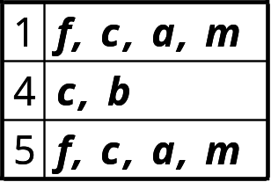
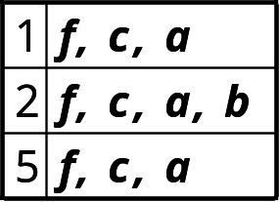
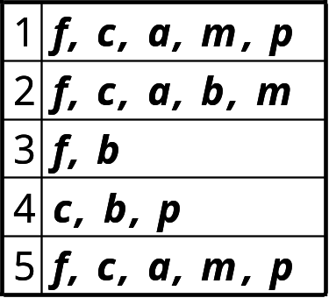
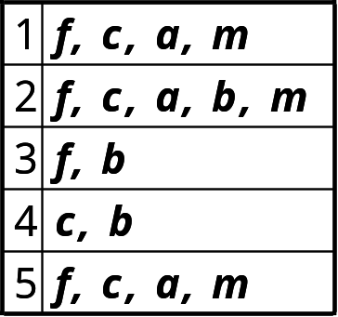
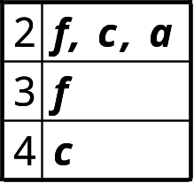
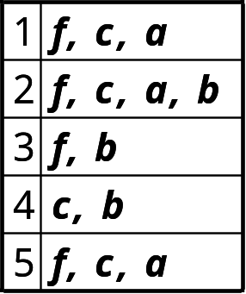
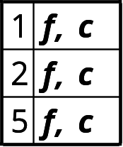
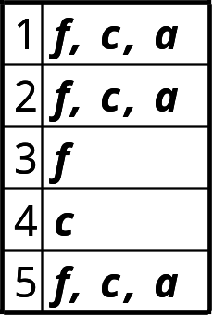
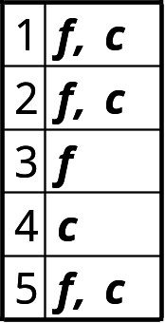
FP-Growth
+ p
+ m
+ b
+ a
Lecture 31- Improving the Efficiency of Apriori, A pattern growth approach, for mining Frequent Itemsets

Slide 48
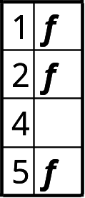
FP-Growth
+ p
+ m
(1)
(2)
+ b
+ a
(3)
(4)
+ c
f: 1,2,3,5
(6)
(5)

Slide 49
{}
{}
f:2
c:1
f:3
c:2
b:1
c:3
{}
a:2
p:1
a:3
f:4
c:1
+ p
b:1
+ m
m:2
c:3
b:1
b:1
(1)
(2)
a:3
p:1
{}
{}
{}
m:2
b:1
f:2
c:1
f:3
f:4
f:3
p:2
m:1
c:1
c:3
+ c
+ a
+ b
a:1
(3)
(4)
(5)
(6)

Slide 50
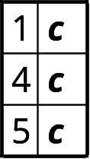
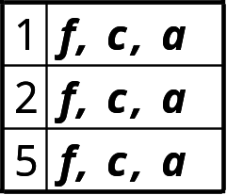
+ p
p: 3
cp: 3
+ p
+ m
m: 3
fm: 3
cm: 3
am: 3
fcm: 3
fam: 3
cam: 3
fcam: 3
min_sup = 3
+ m
+ b
b: 3
a: 3
fa: 3
ca: 3
fca: 3
+ a
c: 4
fc: 3
+ c
f: 1,2,3,5
f: 4

Slide 51
Thank You

